Slide 1
Artificial Intelligence DR.Abeer Amer

Slide 2
Outline
Adversarial Search
( Heuristics in Two-Person Games )
Minimax Procedure
Exhaustive Minimax for Nim (Splitting Stacks)
Minimax to a Fixed Ply Depth
Alpha-Beta Procedure
Alpha-Beta Example
Search … What’s the Issue?
Other Search Techniques
When to Use Search Techniques?

Slide 3
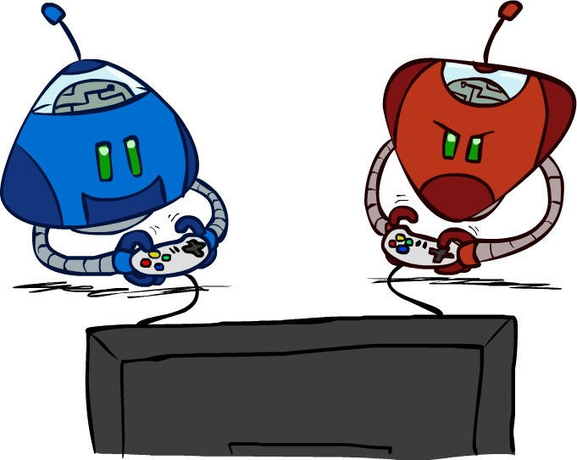
Adversarial Search
( Heuristics in Two-Person Games )
Two players use and apply the same knowledge of the state space in a consistent effort to win the game.
Primary difficulty is in accounting for the actions of the opponent.
Two heuristic pruning procedures:
Minimax procedure.
Alpha-beta procedure.

Slide 4
Minimax Procedure
Minimax values: Computed Recursively
5 max
o Opponents are referred to by MAX.
MIN, and
o MAX player is trying to Maximize his
opportunity to win.
2
5
min
o MIN player is trying to Minimize MAX’s
opportunity to win.
8
2
5
6
Implementation:
Terminal values: part of the game
Label each level of the search graph with MIN or MAX according to the order of playing.
Each leaf node is assigned a value of 0 or 1 depending on whether it is a win for MIN, or MAX.
MAX parent nodes are assigned the maximum of their children.
MIN parent nodes are assigned the minimum of their children.
Derived values are used to choose among possible moves.

Slide 5
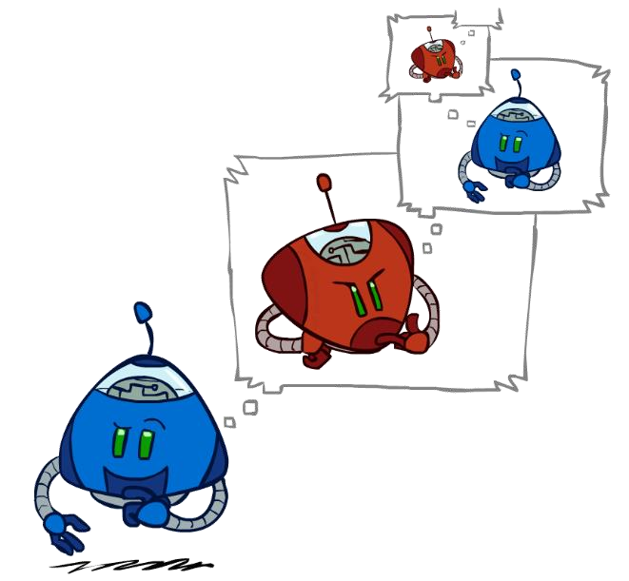
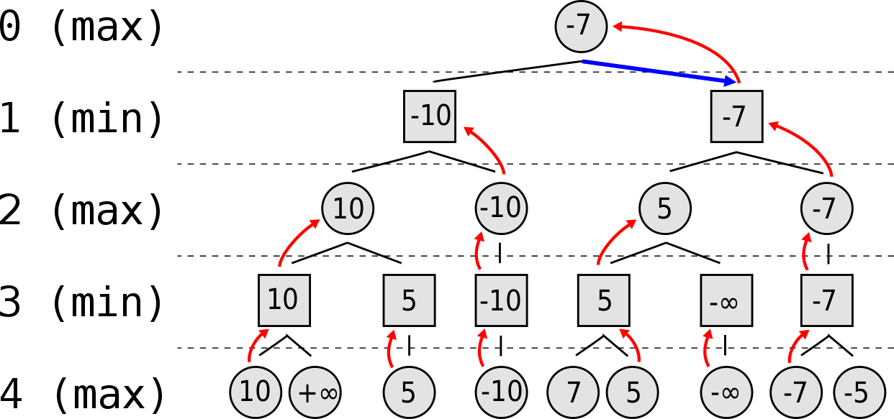
Minimax Tree Example

Slide 6
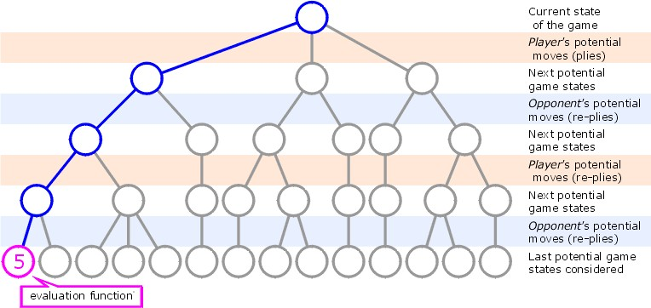
Minimax to a Fixed Ply Depth
Example: Minimax on a 2-player game-tree of 4-plies
.. getting this game state's favourability for player.

Slide 7
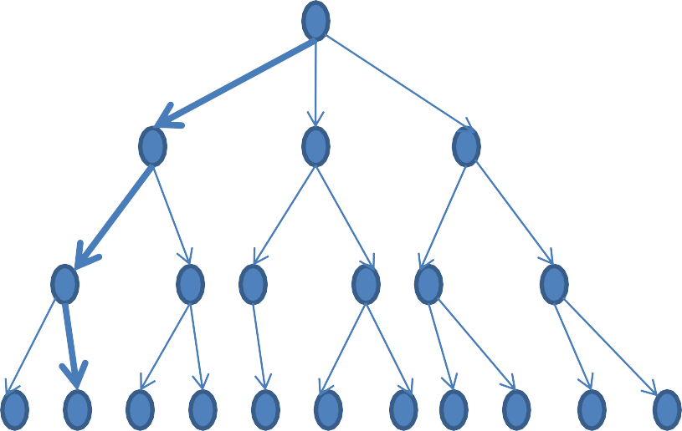
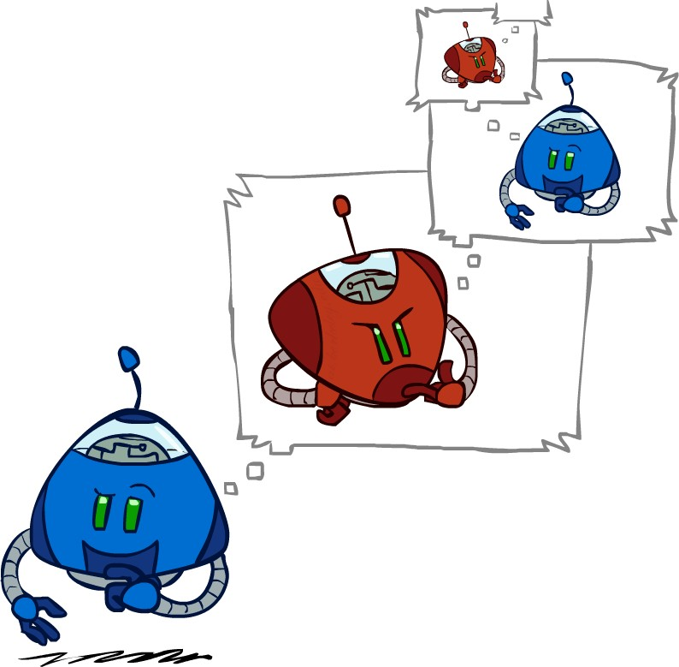
Minimaxto a Fixed Ply Depth
3
MAX
3
0
2
MIN
3
9
0
7
2
6
MAX
MIN
2 3 5 9 0
7
4
2
1 5 6

Slide 8
Alpha–Beta Pruning Procedure
Alpha–beta pruning is a search algorithm that seeks to decrease the number of nodes that are evaluated by the minimax algorithm in its search tree.
It is an adversarial search algorithm used commonly for machine
playing of two-player games (Tic-tac-toe, Chess, Go, etc.).
It stops evaluating a move when at least one possibility has been found that proves the move to be worse than a previously examined move. Such moves need not be evaluated further.
When applied to a standard minimax tree, it returns the same move as minimax would, but prunes away branches that cannot possibly influence the final decision.

Slide 9
Alpha–Beta Pruning Procedure
α: MAX’s best option on path to root β: MIN’s best option on path to root
A search space is explored in depth-first down to the full ply depth.
Apply heuristic evaluation to a state and all its siblings.
For MIN nodes, the maximum is backed up to their parent (a MAX node).
For MAX nodes, the minimum is backed up to their parent (a MIN node).
This value is offered to the grandparent as Beta value for MIN nodes, or Alpha value for MAX nodes.
Alpha is a value associated with MAX nodes, that can never decrease.
Beta is a value associated with MIN nodes, that can never increase.

Slide 10
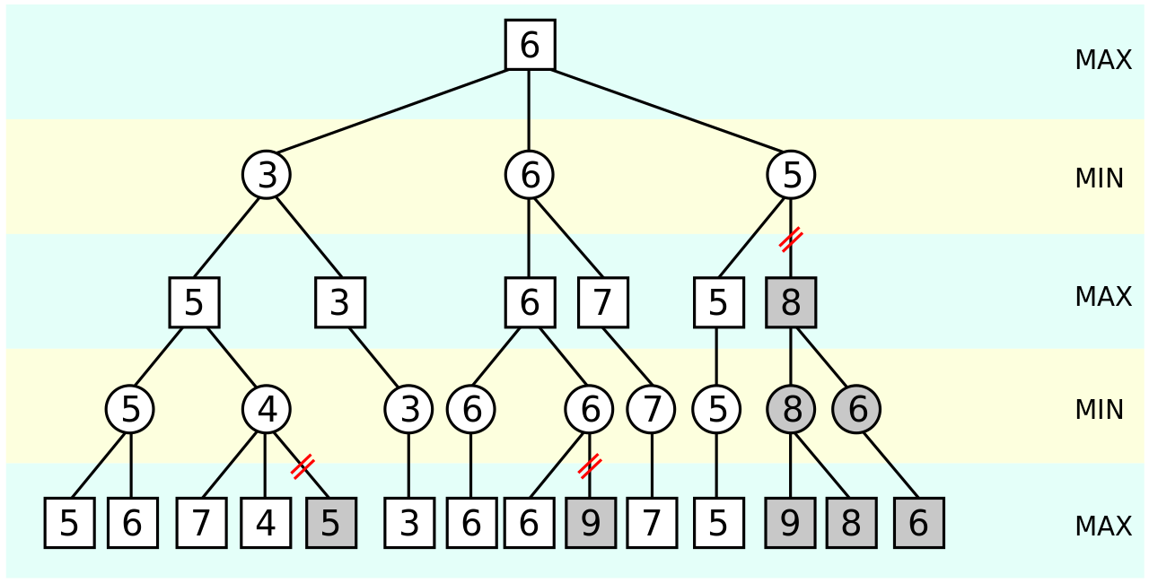
Alpha–Beta Pruning Procedure ..An Illustration
The grayed-out subtrees don't need to be explored (when moves are evaluated from left to right), since we know the group of subtrees as a whole yields the value of an equivalent subtree or worse, and as such cannot influence the final result. The max and min levels represent the turn of the player and the adversary, respectively.

Slide 11
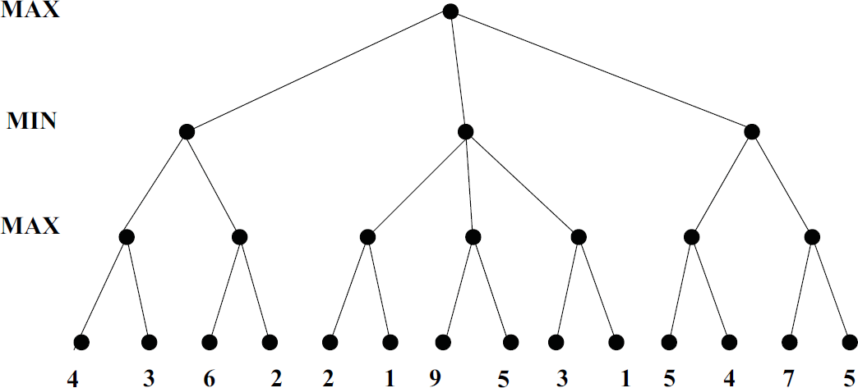
Alpha–Beta Pruning Example

Slide 12
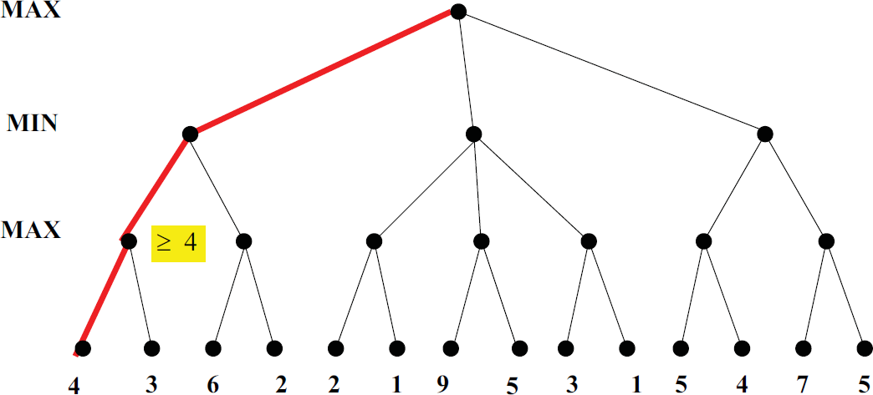
Alpha–Beta Pruning Example

Slide 13
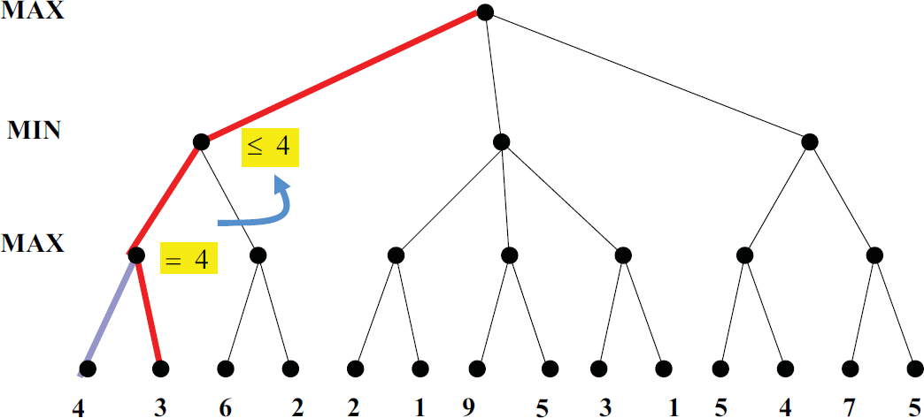
Alpha–Beta Pruning Example

Slide 14
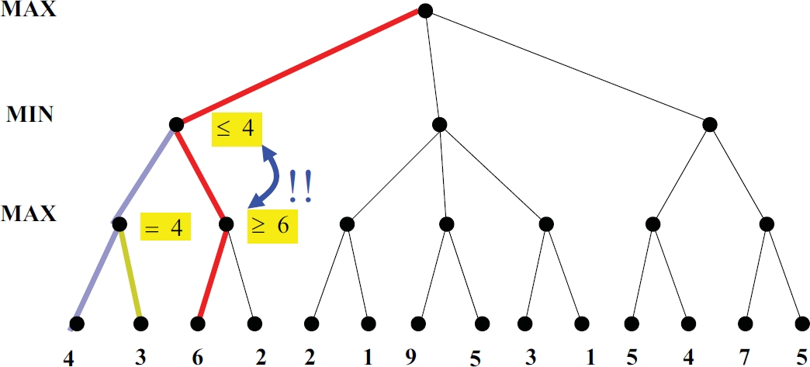
Alpha–Beta Pruning Example

Slide 15
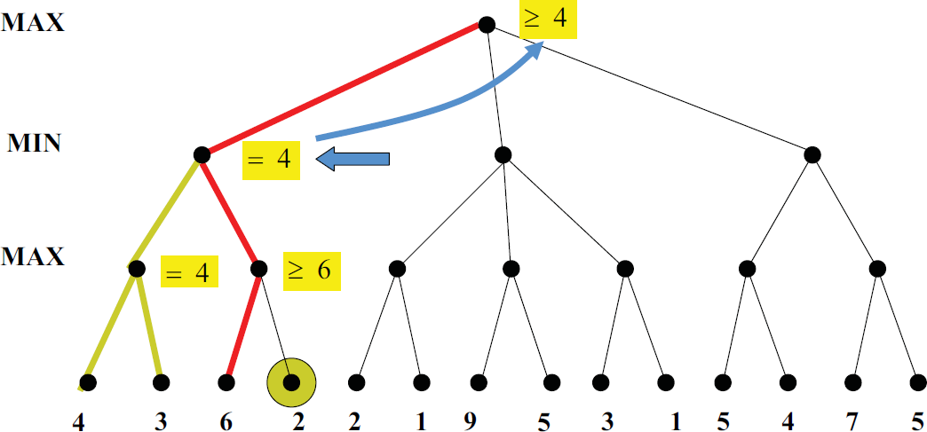
Alpha–Beta Pruning Example

Slide 16
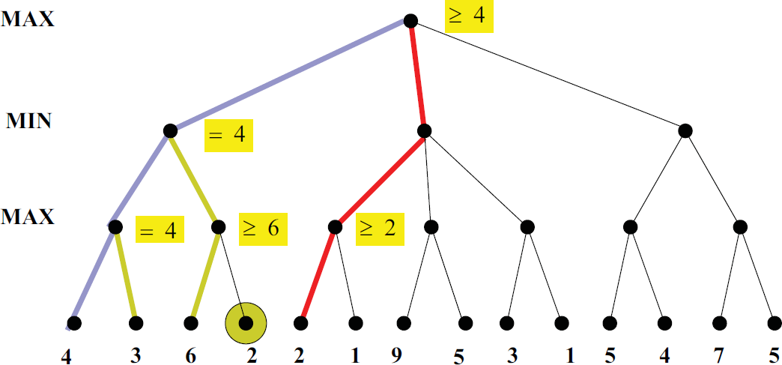
Alpha–Beta Pruning Example

Slide 17
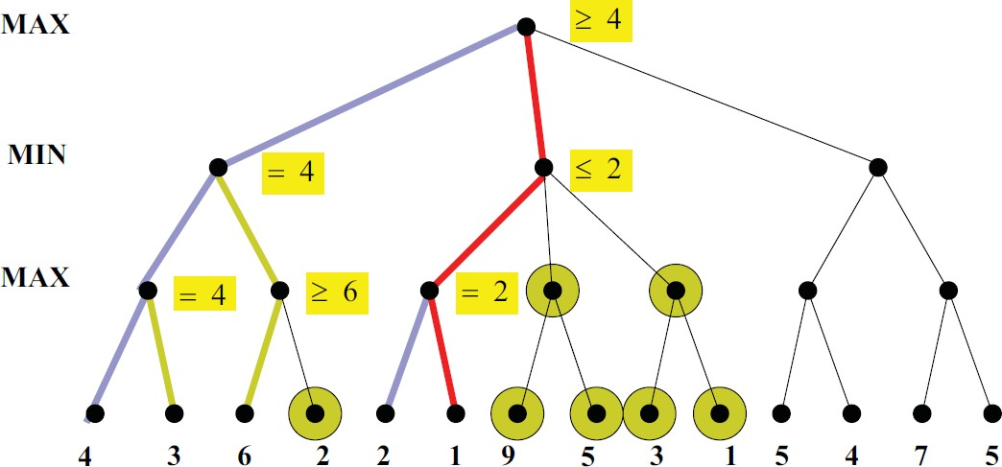
Alpha–Beta Pruning Example

Slide 18
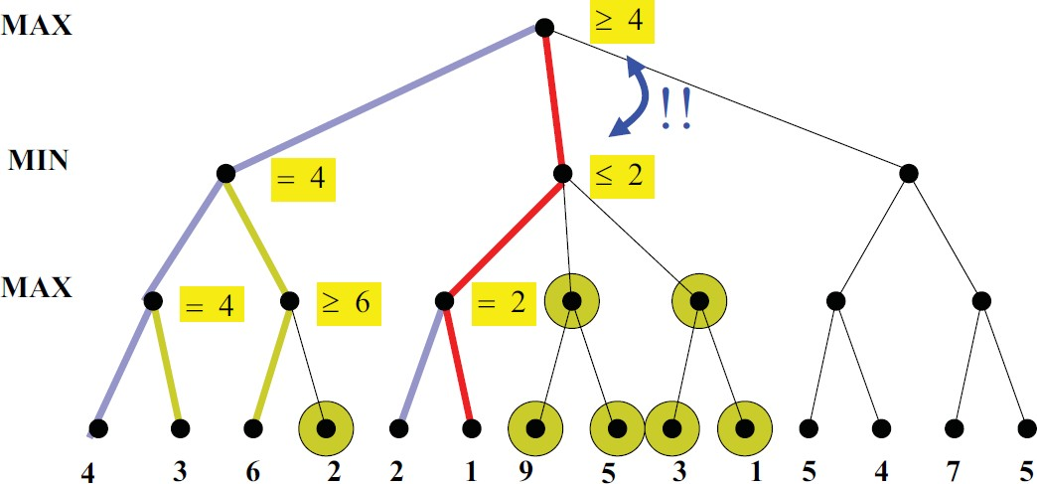
Alpha–Beta Pruning Example

Slide 19
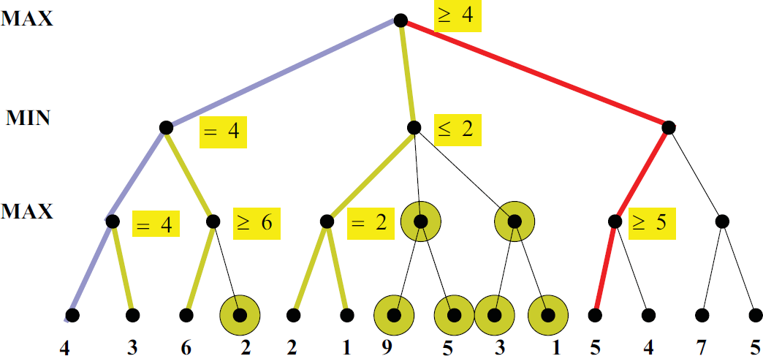
Alpha–Beta Pruning Example

Slide 20
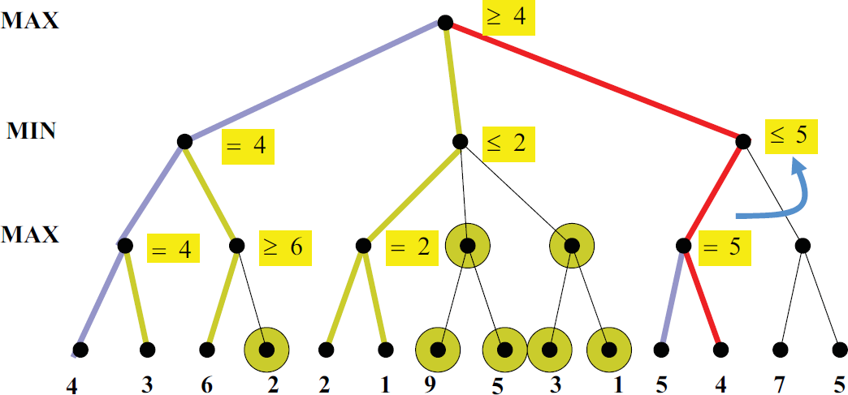
Alpha–Beta Pruning Example

Slide 21
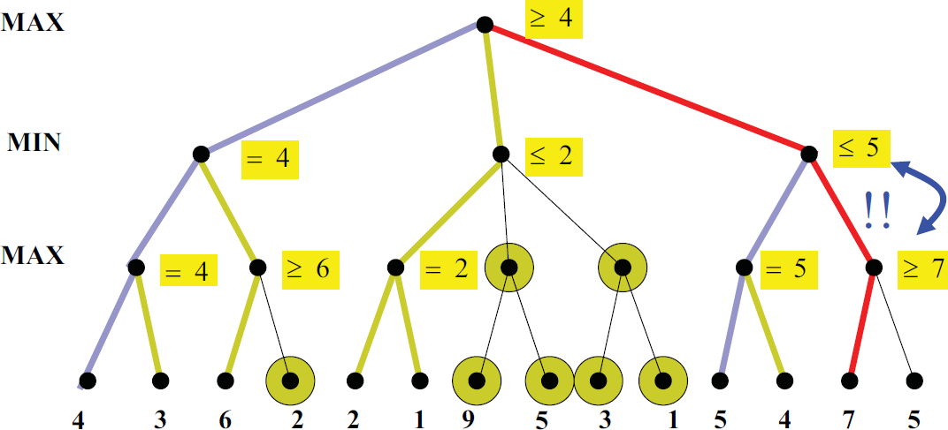
Alpha–Beta Pruning Example

Slide 22
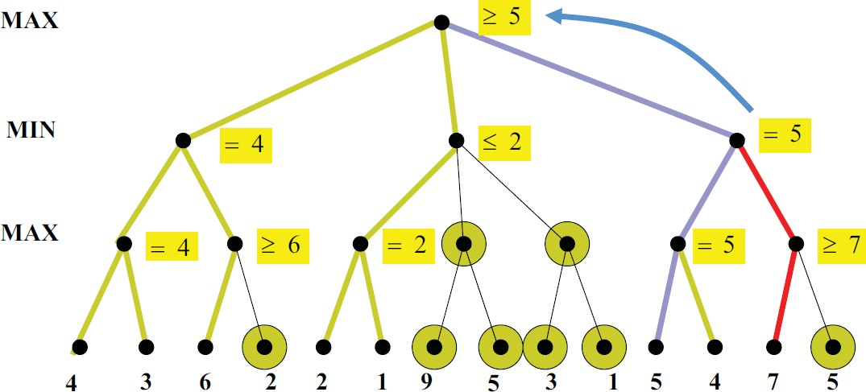
Alpha–Beta Pruning Example

Slide 23
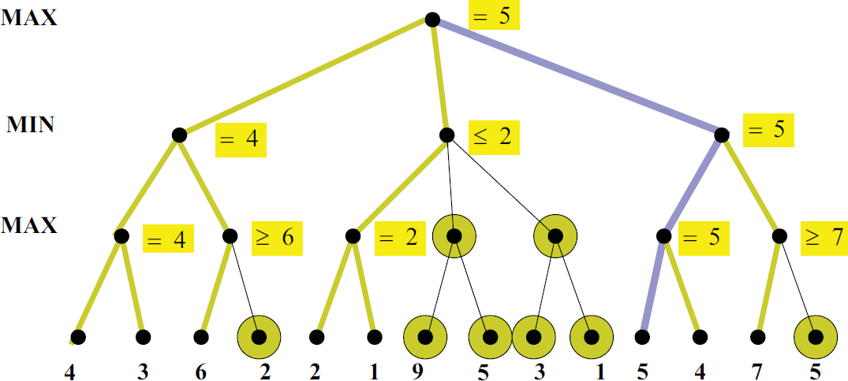
Alpha–Beta Pruning Example

Slide 24

Search .. What’s the Issue?
Search is an iterative local procedure
Good heuristics should provide some global look-ahead (at a low computational cost).

Slide 25
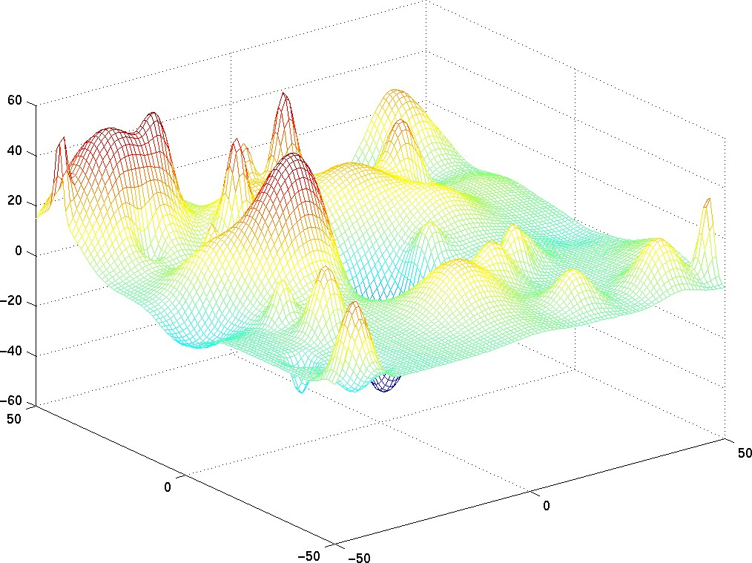
Other Search Techniques
Steepest descent (~ greedy best-first with no search)
→ may get stuck into local minimum

Slide 26
Other Search Techniques
Steepest descent (~ greedy best-first with no search)
→ may get stuck into local minimum
Simulated annealing
Genetic algorithms

